Slide 1

Numpy, Pandas, Visualization - Part 5
Accessing DataFrame Elements, Sorting and Ranking

Slide 2
Accessing DataFrame elements using Indexing

Slide 3
Accessing DataFrame elements using indexing
Indexing is often required in DataFrame to retrieve information
The .iloc[], the .loc[] or some conditions can be used to retrieve the elements
The .iloc[] retrieves the rows and columns by position, and the .loc[] retrieves the elements by the column or row name

Slide 4
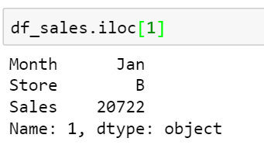
Accessing DataFrame elements using indexing
Retrieve the 2nd row from ‘df_sales’ by using the .iloc[]

Slide 5
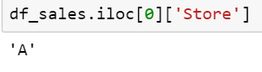
Accessing DataFrame elements using indexing
Retrieve the name of the first store from the ‘df_sales’ dataframe using .iloc[]
Retrieve ‘Store’ from the series
‘0’ index returns the first row as series

Slide 6
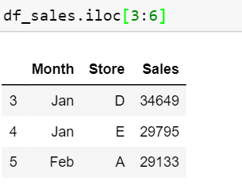
Accessing DataFrame elements using indexing
Retrieve the 4th, 5th, and 6th row in the DataFrame using the .iloc[]

Slide 7
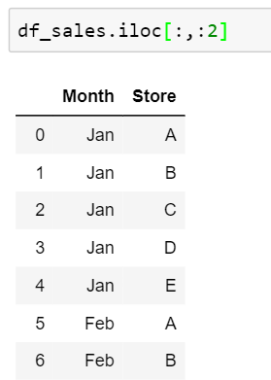
Accessing DataFrame elements using indexing
Select first two columns by using the position of the columns

Slide 8
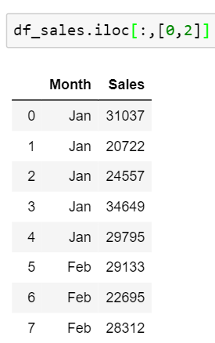
Accessing DataFrame elements using indexing
Find the number of sales corresponding to store using the .iloc[]

Slide 9
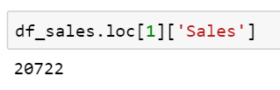
Accessing DataFrame elements using indexing
The .loc[] selects the data by the label of the rows and column
Retrieve the sales of the second store using the .loc[]
Column label
Row index

Slide 10
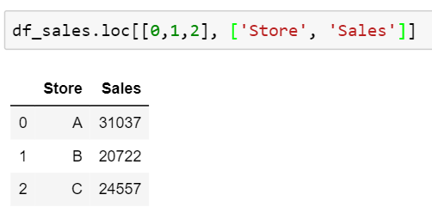
Accessing DataFrame elements using indexing
Retrieve the columns ‘Store’ and ‘Sales’ for first three stores

Slide 11
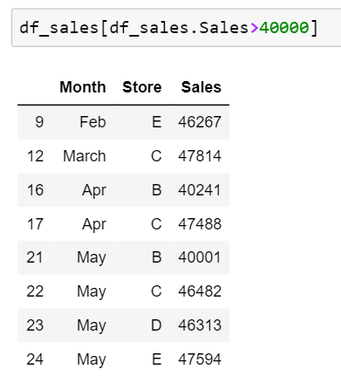
Accessing DataFrame elements using conditions
Retrieve the information of the stores whose sales is more than 40000

Slide 12
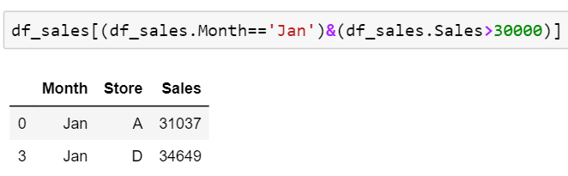
Accessing DataFrame elements using conditions
Retrieve the rows where the sales of the store was greater than 30000 in the month of January

Slide 13
DataFrame Sorting

Slide 14
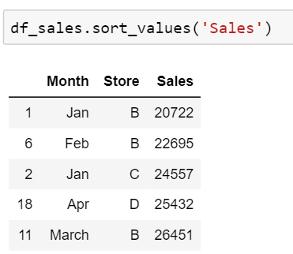
DataFrame Sorting
Sort the rows in ascending order of the column ‘Sales’

Slide 15
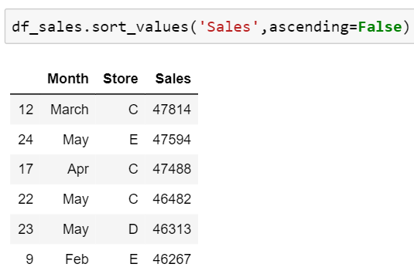
DataFrame Sorting
Sorting rows such that values in the column ‘Sales’ are in the descending order

Slide 16
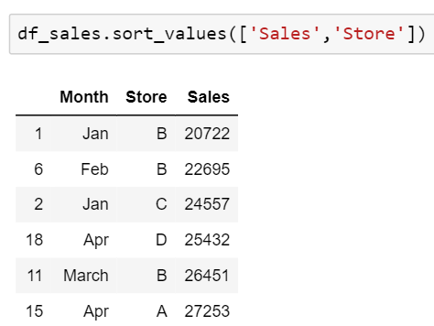
DataFrame Sorting
While sorting the DataFrame by multiple columns, the .sort_values() first sorts the first passed variable and then the next variable
In this case, the function first sorts the variable ‘Sales’ and then the variable ‘Store’

Slide 17
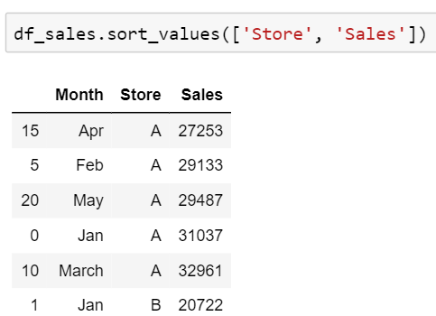
Sort the DataFrame
Sort the DataFrame by values in the columns ‘Store’ and ‘Sales’

Slide 18
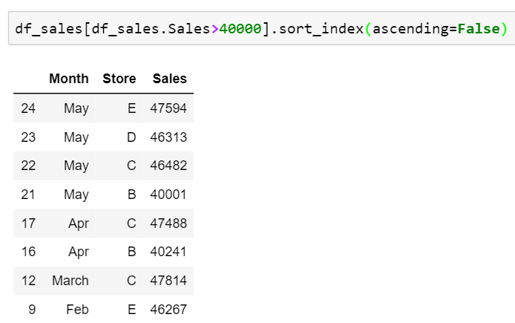
Sort the DataFrame
Get all the rows where Sales > 40000 and then sort all the rows by index using the sort_index() method

Slide 19
Ranking in DataFrame

Slide 20
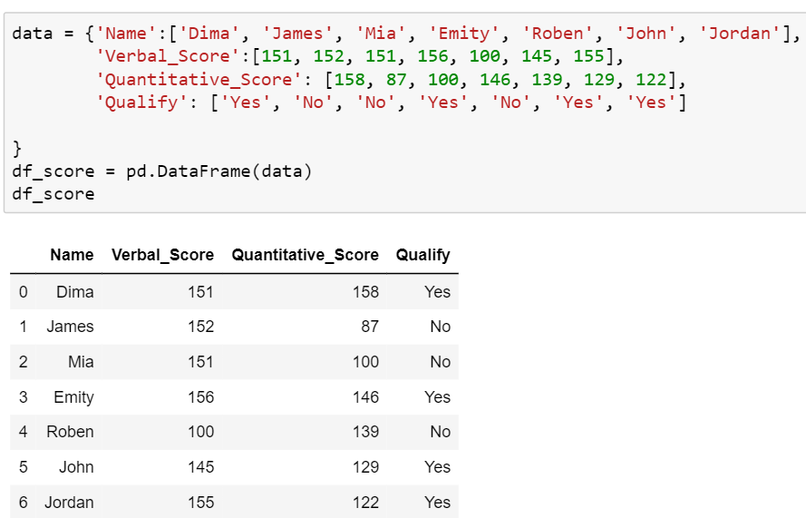
Ranking in DataFrame
Example: Create a DataFrame of seven students as shown below

Slide 21
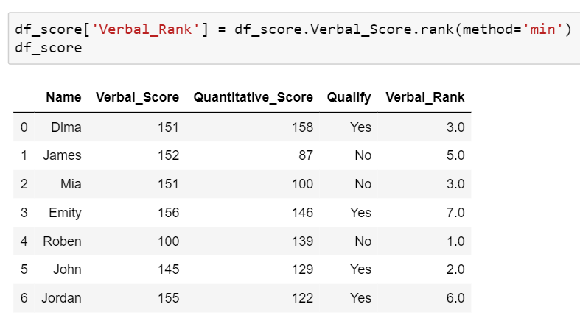
Ranking in DataFrame
Rank the DataFrame by values in the column ‘Verbal_Score’ using the parameter, method = ‘min’
If the Verbal_Score is same for two or more observations, then the ‘min’ method assigns the minimum rank to all the equal scores
Here it assigned the rank ‘3’ to the Verbal_Score = 151

Slide 22
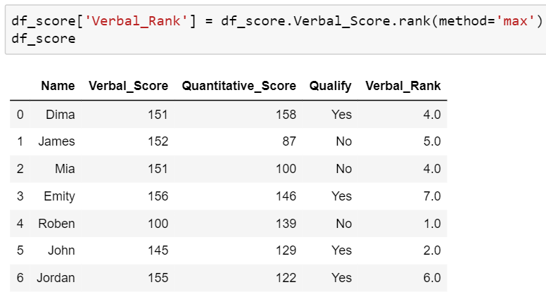
Ranking in DataFrame
Rank the DataFrame by values in the column ‘Verbal_Score’ using the parameter, method = ‘max’
If the Verbal_Score is same for two or more observations, then the ‘max’ method assigns the maximum rank to all the equal scores
Here it assigned the rank ‘4’ to the Verbal_Score = 151

Slide 23
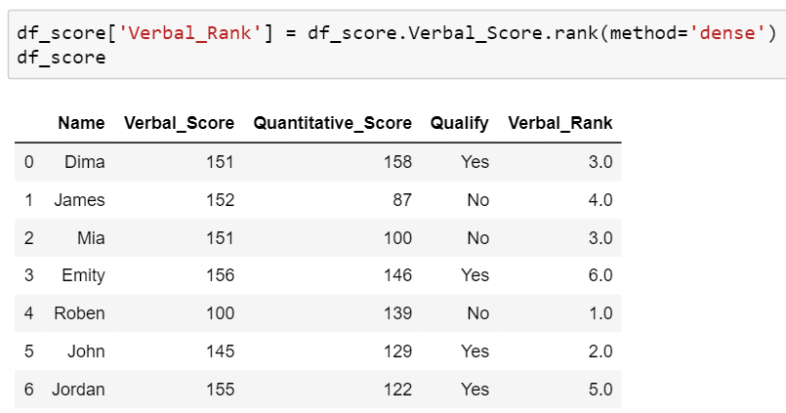
Ranking in DataFrame
Rank the DataFrame by values in the column ‘Verbal_Score’ using the parameter, method = ‘dense’
This method does not skip a rank, like the ‘min’ and ‘max’ method
Here, it assigned the rank ‘3’ to Verbal_Score = 151, and ‘4’ to next greater Verbal_Score = 152

Slide 24
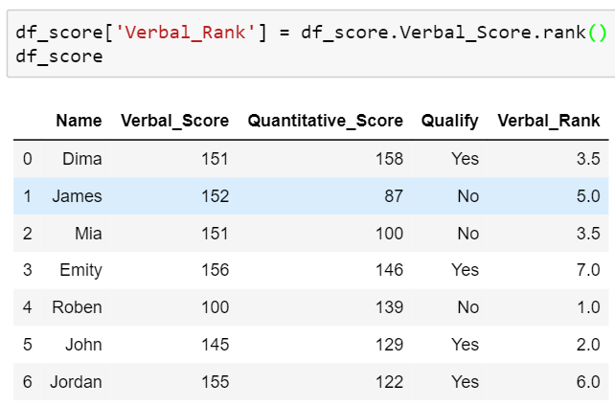
Ranking in DataFrame
Rank the DataFrame by values in the column ‘Verbal_Score ’ in descending order
By default, the method is ‘average’ in the .rank(), and it assigns the average rank to the equal values
Here, it assigned the rank ‘3.5’ to the same Verbal_Score = 151

Slide 25
THANK YOU
Presenter’s Name
Contact Us
support@knowledgehut.com
Presenter’s Designation

